Slide 1
QuickTime Mapper
Edwin Zhang
Urmilkumar Modi
Fahim Talukder

Slide 2

Thought Experiment: Imagine a GIS that...
Can load any map quickly
Has an easy to use simple, user-friendly interface
Presents information intuitively

Slide 3
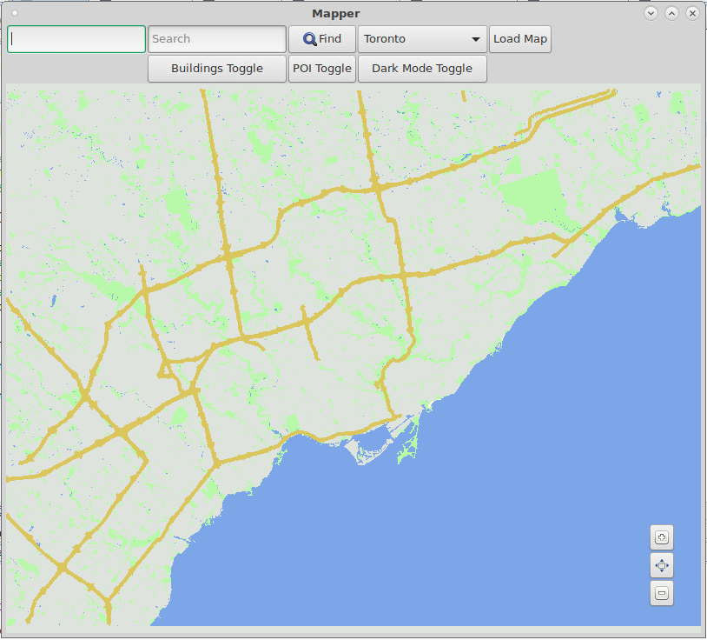
Our Solution

Slide 4
What is our Main Goal?
To create a fast, easy to use GIS with lots of features!

Slide 5
What are our Objectives?
Intuitive layout to maximize Usability
Gather user feedback for improvements
Optimize for Speed and Responsiveness
Refer to SAR from WD1

Slide 6

Usability
How well the software reaches its end goal
Intuitive User-Interface
Display Information for easy and quick access

Slide 7

Toolkit Layout and Zoom
Arrange buttons in an easily accessible manner
Create toggles for binary operations (e.g. Dark Mode)
Create clear and familiar labels for the users to recognize
Background Overlay for the zoom buttons

Slide 8
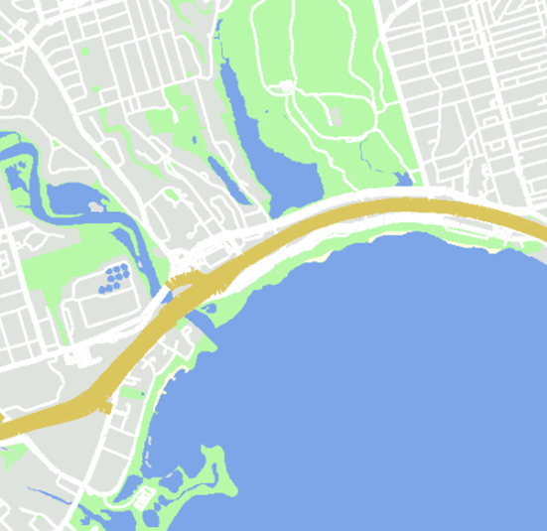
Colours: Conventional Colour Scheme is Intuitive
Lakes, Rivers, Streams – Blue
Parks, Greenspace – Green
Buildings – Grey
Land – Signal White
Highways – Yellow
Streets – White

Slide 9
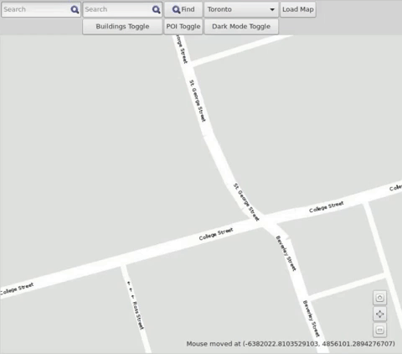
Finding Intersections using Autocomplete
Click on the Search Bar
Type street name
Select from Autocomplete Suggestions
Press the “Find” button or the Enter key

Slide 10
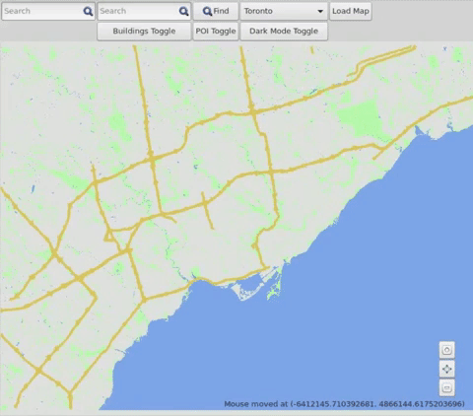
Finding Intersections using Autocomplete
Select City from drop-down menu
Press the “Load Map” Button

Slide 11
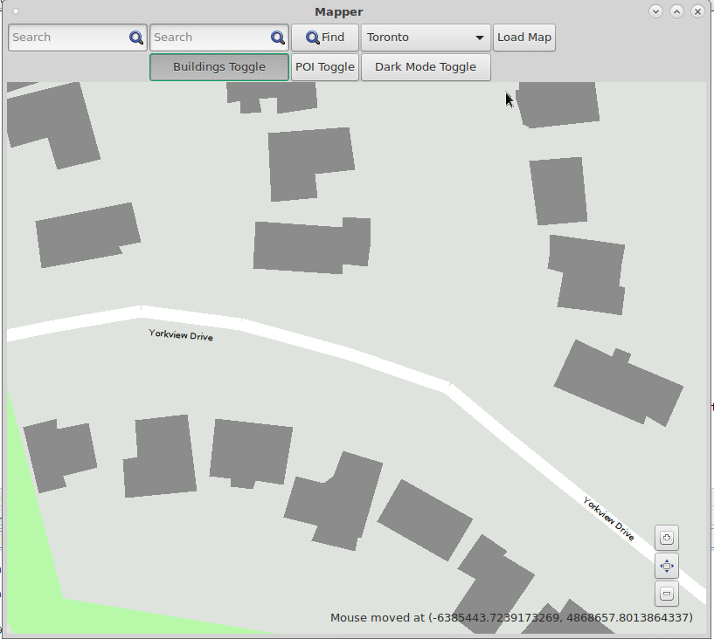
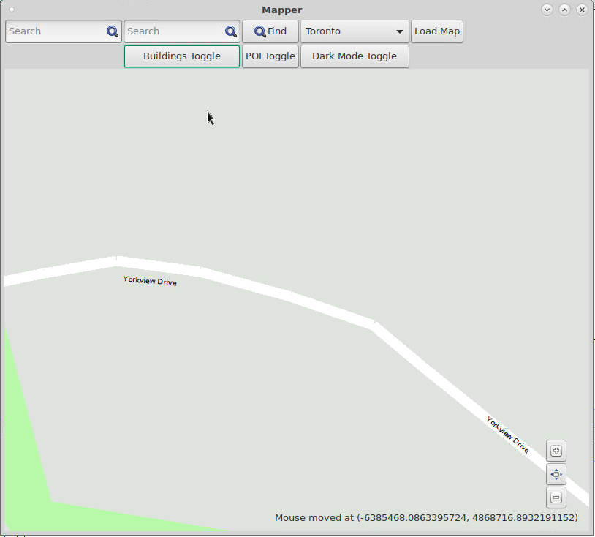
Accessing Building Figures

Slide 12
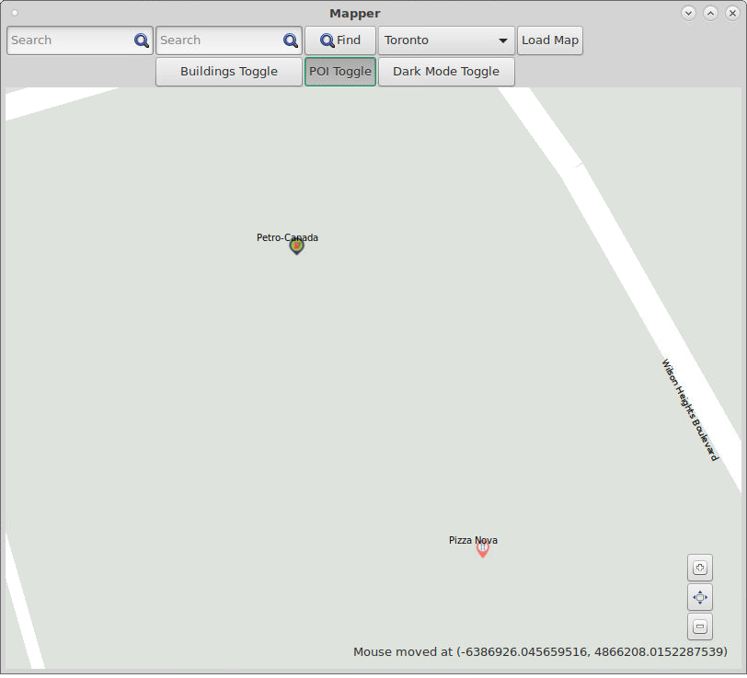
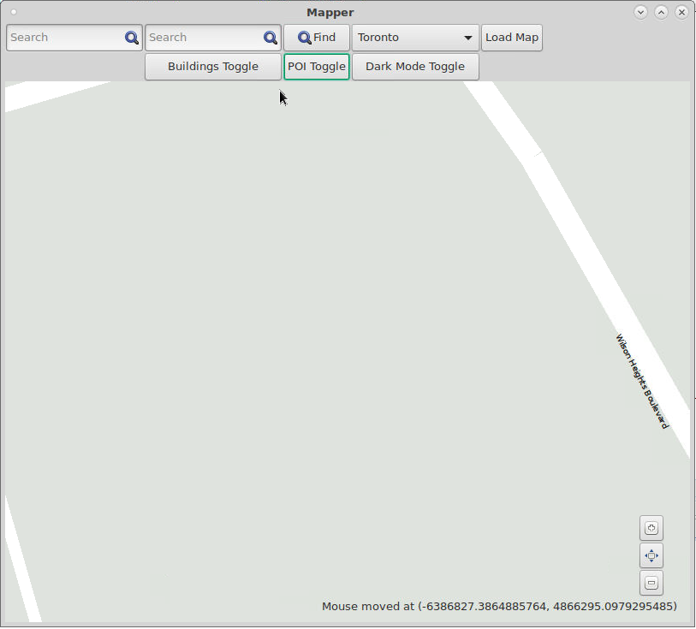
Accessing Point of Interest Information

Slide 13
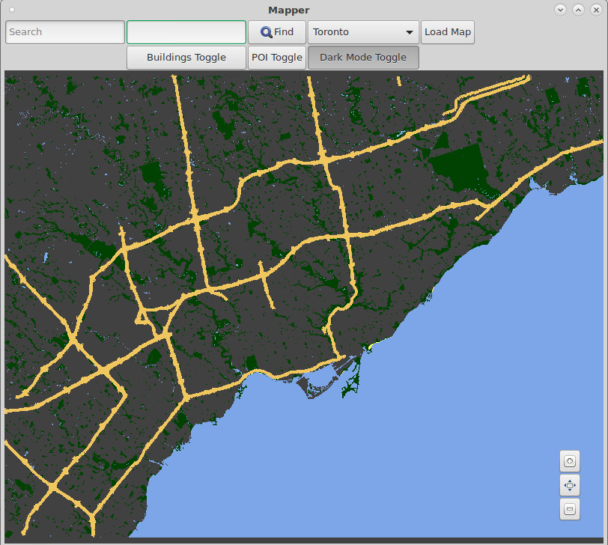
Dark Mode Colour Scheme

Slide 14

Responsiveness
Fast execution speed
Reduced latency
No visual lag

Slide 15
The Problem with Drawing
What The User Can See:
Everything
What The Program Draws:
Everything

Slide 16
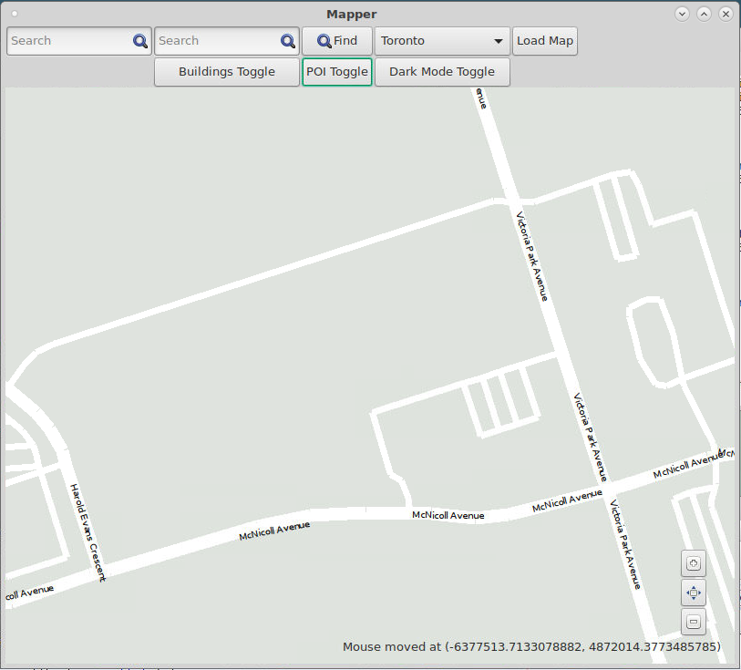
The Problem with Drawing
What The User Can See:
Less than 10 streets
What The Program Draws:
Everything!

Slide 17
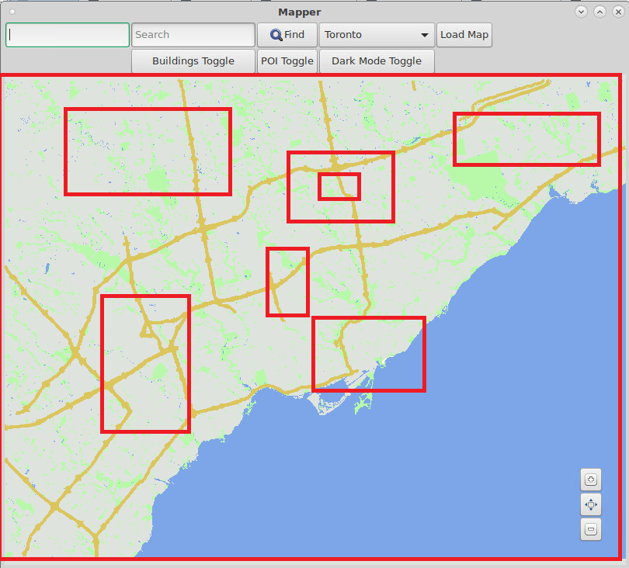
Our Solution
R-Trees: Spatial organization
Organizes data into “boxes”

Slide 18
Our Solution’s Result
What The User Can See:
Less than 10 streets
What The Program Draws:
Less than 10 streets!
“great in terms of responsiveness” – TA

Slide 19
R-Tree Statistics
The R-Tree significantly reduces the refresh time, improving the responsiveness of the map.

Slide 20
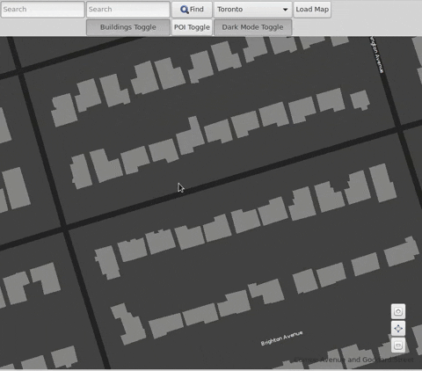
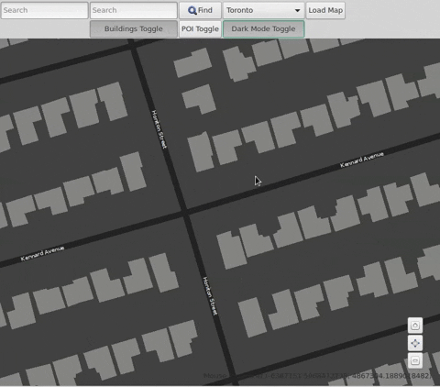
GUI Responsiveness for Panning and Zooming
Standard R-Tree

Slide 21

Problem: Loading the Map is Slow
Loading map can take upwards to 1 minute
Millions of data points

Slide 22
Our Solution: Multi-Threading
Running multiple lines of code concurrently instead of sequentially

Slide 23
Conclusion
Our mapper, QuickTime Mapper is exceptionally fast, easy to use and has lots of features!

